Slide 1
ENSE 477 Mentor Scrum Report-Out
Westside Boys
Daris Lychuk & Kegan Lavoy
February 4th, 2020

Slide 2

Project deats
What problem(s) are you trying to solve?
Make finding the best insurance & medication easy and fast for people without benefits
What gap are you filling?
Comparison between multiple insurance providers
What innovation are you creating?
Web application that auto compares insurance providers based on user input and creates a community of practice with users discussing their experience
Notes:
30 seconds

Slide 3

Project & documentation review
“Show me what you got”
Project Vision: Make finding the best insurance smooth and easy for all types of people. Bring people together by creating communities of practice and a place users can share their experiences
Rationale: Currently quite difficult to even get a quote, even more so to compare between providers
Stakeholders: Insurance providers (URSU so far), people without coverage, government (if their plan is one we use)
Constraints: AWS setup, certain vue.js functionality, mock data
Notes:
1-2 minutes

Slide 4
Project & documentation review
What have we worked on?
AWS setup - have to finish web server setup
Reconsidered the experience and why we are creating what we are creating
Continued front end work using vue.js
Started experience report
Revisited prototypes and developed some quick new ones including our new iterations
Notes:
https://landofooo.storiesonboard.com/m/westside-boys

Slide 5
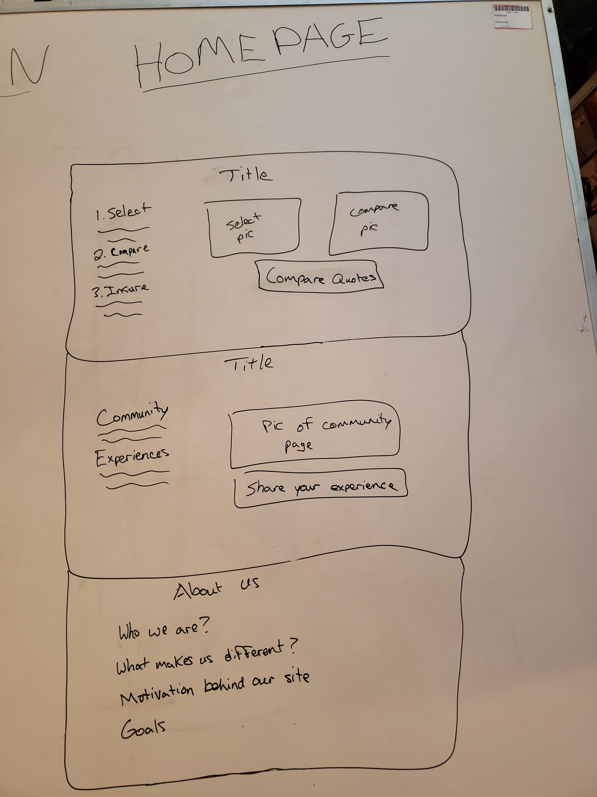
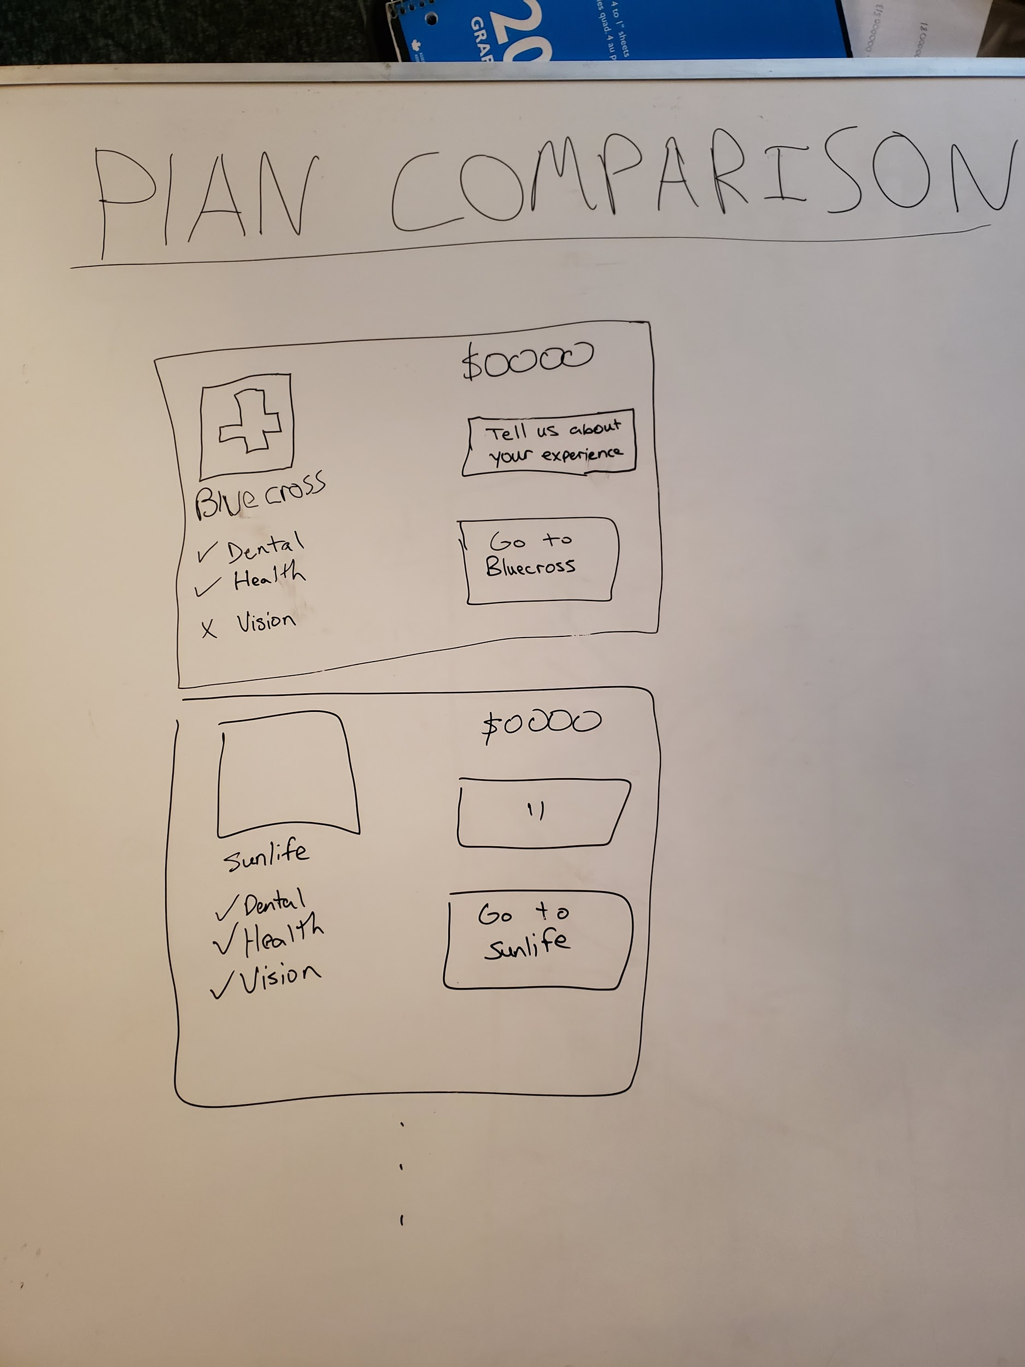

Slide 6
Front-end Prototype Demo

Slide 7

Group reflection
Do you feel you are on track?
We feel slightly behind, due to difficulties and trying to get features to work these past two weeks, however, feel like we have a clearer path as to where we need to go from here
Future steps:
Finish front-end
Start node.js (hopefully close to done by next scrum)
Enter all existing data into the database
Do you feel there are barriers to your success (if any)?
No current API’s for Canadian insurance companies
Getting our web server fully up and running
Notes:
30 seconds

Slide 8
Group reflection
Do you need any help going forward?
We appreciate your suggestions and guidance from yesterday
Any other questions or concerns?
Possibly change our name slightly??
Notes:
30 seconds

Slide 9
Image refs
Show me what you got, https://pictures.abebooks.com/isbn/9781548899530-us-300.jpg
Patrick, https://imgflip.com/memetemplate/43274976/spongebob-patrick-nail-saw
Pondering, https://imgflip.com/s/meme/Question-Rage-Face.jpg

